Slide 1


Business Processes
An Umbrex Toolkit

Slide 2
Contents
Acceptance to Deployment
Acceptance to Payment
Activation to Support
Application to Approval
Audit to Compliance
Campaign to Conversion
Change Implementation to Validation
Change Request to Implementation
Concept to Commercialization
Concept to Completion
Concept to Creation
Concept to Prototype
Contract to Close
Customer Acquisition to Retention
Customer Inquiry to Response
Delivery to Installation
Deployment to Evaluation
Deployment to Maintenance
Design to Build
Design to Delivery
Design to Prototype
Development to Testing
Estimate to Invoice
Evaluation to Closure
Forecast to Fulfill
Hire to Retire
Idea to Launch
Idea to Patent
Idea to Product
Incident to Resolution
Inspection to Acceptance
Installation to Activation
Lead to Close
Maintenance to Retirement
Opportunity to Order
Opportunity to Quote
Opportunity to Revenue
Order to Cash
Order to Delivery
Plan to Hire
Plan to Produce
Plan to Profit
Procure to Pay
Product to Market
Production to Distribution
Proposal to Approval
Prospect to Customer
Prospect to Proposal
Prototype to Production
Quote to Cash
Quote to Order
Receipt to Inspection
Record to Archive
Record to Reconcile
Recruitment to Onboarding
Release to Deployment
Renewal to Retention
Request to Delivery
Request to Fulfillment
Requirement to Implementation
Requirements to Design
Research to Results
Sales to Service
Service Request to Fulfillment
Source to Pay
Testing to Acceptance
Testing to Release
Validation to Deployment
Visitor to Lead

Slide 3
Acceptance to Deployment
Acceptance: The first step in the process is to gather requirements and ensure that all stakeholders have agreed to the project scope and goals. This includes identifying the key features and functions that the project will deliver, as well as any constraints or limitations that need to be considered.
Design: Once the requirements have been defined and agreed upon, the next step is to design the system architecture and user interface. This involves creating a detailed plan that outlines how the system will be built, including the technologies and tools that will be used.
Development: With the design plan in place, the development team can begin building the system. This involves writing code, creating user interfaces, and testing the system to ensure that it meets the requirements and functions as intended.
Testing: After the development phase is complete, the system must be thoroughly tested to ensure that it is stable, secure, and bug-free. This includes unit testing, integration testing, and system testing to ensure that all components work together as expected.
Deployment: Once the system has been fully tested and all issues have been resolved, it can be deployed to production. This involves installing the software on the target environment and ensuring that it runs smoothly.
Maintenance: Once the system is live, it will need ongoing maintenance to ensure that it remains stable and secure. This includes monitoring the system for issues and applying updates and patches as needed.

Slide 4
Acceptance to Payment
Acceptance: The first step in the process is to receive an order from a customer. This could be through an online store, a sales representative, or any other sales channel. The order should include all the necessary details such as the product, quantity, price, and any special requests or instructions.
Review: Once the order has been received, it must be reviewed to ensure that it is accurate and complete. This includes verifying that the product is in stock, the price is correct, and any special requests or instructions are feasible.
Confirmation: After the order has been reviewed, the next step is to confirm the order with the customer. This may involve sending an email or making a phone call to ensure that the customer is aware of the order and agrees to the terms.
Fulfillment: With the order confirmed, the next step is to fulfill the order. This involves picking the product from inventory, packaging it for shipment, and arranging for delivery.
Shipment: Once the order is packaged and ready to go, it can be shipped to the customer. This may involve using a courier service or arranging for pickup by the customer.
Invoice: After the product has been shipped, an invoice must be generated and sent to the customer. This should include all the necessary details such as the product, quantity, price, and any taxes or fees.
Payment: Finally, the customer must make payment for the order. This may involve using a credit card, bank transfer, or any other payment method that has been agreed upon.

Slide 5
Activation to Support
Activation: The first step in the process is to activate the customer's account. This involves verifying their identity, setting up their account, and providing any necessary onboarding information.
Training: Once the account has been activated, the next step is to provide training to the customer. This could be in the form of an online tutorial, a video demonstration, or a live training session. The goal is to ensure that the customer understands how to use the product or service and can get started quickly.
Configuration: After the customer has been trained, the next step is to help them configure the product or service to their specific needs. This may involve customizing settings, integrating with other systems, or setting up workflows.
Launch: Once the product or service has been configured, it can be launched. This involves making it available to the customer and ensuring that it is functioning as expected.
Support: With the product or service launched, the final step is to provide ongoing support to the customer. This could include responding to support tickets, providing technical assistance, or troubleshooting issues as they arise.

Slide 6
Application to Approval
Application: The first step in the process is for the applicant to submit an application for the service or program. This application typically includes personal information, financial information, and other relevant details.
Verification: Once the application has been submitted, the next step is to verify the information provided by the applicant. This may involve checking credit reports, contacting references, or reviewing supporting documents.
Evaluation: After the information has been verified, the application can be evaluated to determine whether the applicant meets the eligibility criteria for the service or program. This evaluation may be based on factors such as income, credit history, or other relevant criteria.
Approval: If the applicant meets the eligibility criteria, the next step is to approve their application. This may involve notifying the applicant of their approval and providing them with any necessary documentation.
Rejection: If the applicant does not meet the eligibility criteria, their application may be rejected. This may involve notifying the applicant of the reasons for their rejection and providing them with any relevant information about alternative services or programs.

Slide 7
Audit to Compliance
Planning: The first step in the process is to plan the audit. This involves identifying the scope of the audit, determining the objectives, and developing a plan for the audit.
Fieldwork: The next step is to conduct the audit fieldwork. This involves collecting data, testing controls, and gathering evidence to assess the level of compliance.
Analysis: Once the fieldwork is complete, the next step is to analyze the data and evidence collected. This involves comparing the findings to the relevant regulations and standards, identifying any gaps or deficiencies, and determining the level of compliance.
Reporting: After the analysis is complete, the next step is to prepare a report on the findings. This report typically includes a summary of the audit objectives, the scope of the audit, the methodology used, the findings, and any recommendations for improving compliance.
Follow-up: Finally, the last step is to follow up on the audit findings. This involves communicating the findings and recommendations to the relevant stakeholders, tracking the implementation of any corrective actions, and conducting additional audits if necessary.

Slide 8
Campaign to Conversion
Campaign Planning: The first step in the process is to plan the marketing campaign. This involves identifying the target audience, determining the objectives of the campaign, and developing a plan for reaching the target audience.
Campaign Execution: The next step is to execute the marketing campaign. This may involve using various marketing channels such as email, social media, or paid advertising to reach the target audience and promote the product or service.
Lead Generation: Once the campaign is underway, the next step is to generate leads. This involves identifying potential customers who have shown an interest in the product or service and capturing their contact information.
Lead Nurturing: After leads have been generated, the next step is to nurture those leads. This involves building relationships with potential customers and providing them with valuable content and information to help them make an informed decision.
Conversion: Finally, the last step is to convert leads into customers. This may involve using various strategies such as special offers, discounts, or personalized messaging to encourage the lead to take action and purchase the product or service.

Slide 9
Change Implementation to Validation
Planning: The first step in the process is to plan the change implementation. This involves identifying the need for the change, defining the scope of the change, and developing a plan for implementing the change.
Implementation: The next step is to implement the change. This may involve modifying systems or processes, updating documentation, or retraining employees.
Testing: Once the change has been implemented, the next step is to test the change. This involves verifying that the change has been implemented correctly and that it is functioning as intended.
Validation: After testing is complete, the next step is to validate the change. This involves reviewing the results of the testing and verifying that the change has achieved its intended objectives.
Documentation: Finally, the last step is to document the change implementation and validation. This involves updating any relevant documentation, such as procedures, work instructions, or training materials, to reflect the change.

Slide 10
Change Request to Implementation
Change Request: The first step is to receive a change request. This request may come from various sources, such as customers, employees, or stakeholders. The change request should include a description of the change, the reason for the change, and any other relevant information.
Assessment: The next step is to assess the change request. This involves reviewing the request, evaluating its impact, and determining whether the change is feasible and necessary. The assessment may also involve estimating the resources and time required to implement the change.
Approval: Once the change request has been assessed, the next step is to obtain approval. This may involve seeking approval from various stakeholders, such as senior management, quality assurance, or regulatory bodies. The approval process may also include reviewing and approving any changes to project plans or budgets.
Implementation: After approval has been obtained, the next step is to implement the change. This may involve modifying systems or processes, updating documentation, or retraining employees. The implementation process should be managed and monitored to ensure that it is completed on time and within budget.
Testing: Once the change has been implemented, the next step is to test the change. This involves verifying that the change has been implemented correctly and that it is functioning as intended. Testing may include functional, performance, and integration testing, as well as user acceptance testing.
Rollout: Finally, the last step is to rollout the change. This involves deploying the change to production systems, releasing updated documentation, and communicating the change to stakeholders. The rollout process should be managed carefully to minimize disruptions and ensure that users are informed and trained on any changes.

Slide 11
Concept to Commercialization
Concept Development: The first step in the process is to develop the concept for the new product. This involves identifying a market need or opportunity and coming up with an idea for a product that will address that need or opportunity.
Feasibility Study: Once the concept has been developed, the next step is to conduct a feasibility study. This involves analyzing the technical, financial, and market feasibility of the product. The feasibility study will help determine whether the product is viable and whether it is worth pursuing further.
Design and Development: If the feasibility study indicates that the product is viable, the next step is to design and develop the product. This involves creating detailed specifications for the product, building prototypes, and testing the product to ensure that it meets the specifications and functions properly.
Testing and Validation: After the product has been designed and developed, the next step is to test and validate it. This involves conducting various tests to ensure that the product meets quality, safety, and regulatory standards. Validation may also involve obtaining feedback from potential customers and making any necessary modifications to the product.
Launch Planning: Once the product has been tested and validated, the next step is to plan for its launch. This involves developing a marketing strategy, identifying distribution channels, and creating a launch plan that includes timelines, budgets, and key performance indicators.
Commercialization: The final step in the process is to commercialize the product. This involves producing the product, launching it, and marketing it to potential customers. Commercialization also involves ongoing monitoring and improvement of the product to ensure that it continues to meet customer needs and expectations.

Slide 12
Concept to Completion
Ideation: This is the initial stage where the idea or concept is generated. This could be done by brainstorming, market research, or even by identifying gaps or problems in the market that the concept can address.
Feasibility Analysis: Once the idea has been generated, a feasibility analysis is conducted to determine if the idea is realistic and viable. This may involve conducting market research, identifying potential resources or partners, assessing potential risks and challenges, and estimating the costs and resources required.
Design: In this stage, the idea is developed into a concrete plan or design. This may include creating sketches, blueprints, or prototypes, as well as developing a more detailed project plan that outlines the various tasks, milestones, and resources required.
Development: Once the design has been finalized, the development stage begins. This could involve building a physical prototype, developing software or other technology, or creating content such as marketing materials or written content.
Testing and Quality Assurance: Before the concept can be completed, it must be tested and assessed for quality. This may involve conducting user testing, running simulations or prototypes, or conducting other forms of quality assurance testing.
Launch: Once the concept has been tested and refined, it is ready for launch. This could involve releasing a new product, launching a new marketing campaign, or launching a new service.
Post-Launch Evaluation: After the concept has been launched, it is important to evaluate its success and impact. This may involve analyzing sales data, conducting customer surveys or focus groups, or other forms of evaluation.
Completion: Finally, the project is considered complete once it has been launched and evaluated. However, ongoing maintenance or improvements may be required to ensure the success of the project in the long-term.

Slide 13
Concept to Creation
Ideation: This is the first step where the initial idea is generated based on a need, market gap or an opportunity. The idea is brainstormed and discussed among the team to refine and define the concept.
Concept Development: This stage involves researching and analyzing the feasibility of the idea. The concept is then developed into a clear, concise and comprehensive plan that outlines the target market, resources needed, revenue potential, and the risks associated with the project.
Business Case Development: This is where the concept is further analyzed to determine its financial viability. A business case is created to justify the investment of resources and to secure support and funding for the project.
Design: This stage involves the design and development of the product, service, or project. This may include market research, user experience design, prototype creation, and testing.
Development: Once the design is complete, the actual development of the product, service, or project begins. This stage involves coding, manufacturing, and production.
Testing: This stage involves rigorous testing of the product or service to ensure that it meets quality standards and performs as expected. This may include user testing, stress testing, and performance testing.
Launch: This is the final stage where the product, service, or project is launched to the market or target audience. This may involve a marketing campaign, a product release, or the opening of a new business.
Post-Launch Evaluation: After launch, the product, service, or project is evaluated to determine its success and to identify areas for improvement. Feedback is collected from customers, stakeholders, and team members to refine and improve the product or service.
Maintenance and Support: This is an ongoing process where the product, service, or project is maintained and supported to ensure that it continues to meet the needs of customers and stakeholders. This may include bug fixes, updates, and customer support.

Slide 14
Concept to Prototype
Ideation: This is the initial step where the concept of the product is conceived. Brainstorming, market research, and competitor analysis are carried out during this phase to come up with a unique product idea.
Concept Development: Once the idea is formed, it is analyzed further to create a feasible product concept. This includes defining the product's features, target audience, and identifying any potential challenges in the process.
Design Planning: This step involves mapping out the product design process. The design team outlines the steps necessary to achieve the product's final design, and assigns tasks and deadlines to team members.
Design Execution: This is where the actual product design takes place. The team creates sketches, drawings, and 3D models to bring the concept to life. Prototyping software may be used to create digital representations of the product.
Prototype Testing: Once the design is complete, the prototype is built and tested. This step is critical to identify any design flaws, user experience issues, or technical challenges.
Prototype Refinement: Based on the testing results, the prototype is refined and improved. This may involve making changes to the design, addressing technical issues, or adjusting the product features.
Finalizing the Prototype: Once the testing and refinement are complete, the final prototype is developed. It should be a working, functional model that closely resembles the final product.
Prototype Approval: The prototype is reviewed by stakeholders, including investors, product managers, and customers to determine if it meets the product specifications and requirements.
Handover to Manufacturing: After the prototype is approved, it is handed over to the manufacturing team. The manufacturing team will then use the prototype as a blueprint for creating the final product.

Slide 15
Contract to Close
Contract negotiation: This is the stage where the buyer and seller negotiate the terms and conditions of the contract, such as the purchase price, contingencies, and closing date.
Contract signing: Once the terms of the contract have been agreed upon, the parties sign the contract.
Escrow and earnest money deposit: The buyer typically puts a deposit (called "earnest money") into an escrow account to show that they are serious about the purchase.
Due diligence: The buyer typically has a period of time to conduct due diligence, which may include inspections, appraisals, and other investigations to ensure the property is in good condition and meets their needs.
Financing and appraisal: If the buyer is obtaining financing, they will typically need to secure a loan and have an appraisal performed to ensure the property is worth the purchase price.
Title search and insurance: The buyer's attorney or title company will typically perform a title search to ensure there are no liens or other encumbrances on the property. The buyer may also purchase title insurance to protect against any title defects that may arise in the future.
Closing disclosure and loan documents: The lender will provide the buyer with a closing disclosure, which outlines the costs associated with the loan. The buyer will also sign the loan documents.
Closing: At the closing, the buyer and seller sign all necessary documents, the buyer pays any remaining costs and the seller receives the purchase price. The property is transferred to the buyer, and the transaction is considered "closed."

Slide 16
Customer Acquisition to Retention
Identify Target Audience: In this stage, the target audience is identified based on the company's product or service. This could be based on demographics, interests, or other criteria.
Lead Generation: This is the process of attracting potential customers and converting them into leads. This could be done through various channels like social media, email marketing, content marketing, or paid advertising.
Lead Qualification: This stage involves determining whether the leads generated are a good fit for the company's product or service. This could be done by collecting information about the leads or by using lead scoring models.
Sales Pitch: In this stage, the sales team pitches the product or service to the qualified leads. This could be done through email, phone calls, or in-person meetings.
Closing the Sale: If the prospect is interested in the product or service, the sales team will work to close the deal. This involves negotiating terms, finalizing contracts, and receiving payment.
Onboarding: Once the customer has made a purchase, the onboarding process begins. This involves welcoming the customer and providing them with the necessary information to use the product or service effectively.
Customer Support: This stage involves providing support to the customer if they have any issues or questions about the product or service.
Engagement: Keeping the customer engaged with the company's product or service is critical to customer retention. This could be done through email campaigns, loyalty programs, or other initiatives.
Retention: Retaining customers is important for the long-term success of the company. This stage involves monitoring customer satisfaction, addressing any issues, and providing ongoing value to the customer.
Upselling and Cross-Selling: In this stage, the company looks for opportunities to sell additional products or services to existing customers. This could be done through email campaigns or other marketing initiatives.

Slide 17
Customer Inquiry to Response
Inquiry receipt: The process starts with the receipt of the customer inquiry. This can come through various channels such as phone, email, chat, social media, or other forms of communication.
Inquiry classification: Once the inquiry is received, it needs to be classified according to the nature of the inquiry. This can be done through automated tools or manually by customer service representatives.
Inquiry triage: After the inquiry is classified, it needs to be triaged to the right person or team who can handle the inquiry effectively. This may involve routing the inquiry to a specific department or individual within the organization.
Inquiry investigation: The person or team who receives the inquiry will then investigate the customer's question or issue to understand the root cause of the problem.
Response formulation: After the inquiry is investigated, a response needs to be formulated to address the customer's question or issue. This can involve providing an answer, solution, or next steps for the customer.
Response delivery: The response is then delivered back to the customer through the same or different communication channel as the initial inquiry.
Follow-up: After the response is delivered, it's important to follow up with the customer to ensure that their inquiry was resolved to their satisfaction.
Feedback collection: Finally, feedback should be collected from the customer on their experience with the inquiry and response process. This feedback can be used to improve the overall process and customer experience.

Slide 18
Delivery to Installation
Order fulfillment: This is the process of fulfilling the order by picking, packing, and preparing the product for shipping. This includes quality control checks, packaging, and labeling.
Shipping: The product is shipped from the warehouse or distribution center to the customer or the installation location. The shipping process can involve various modes of transportation and carriers, depending on the size and weight of the product.
Delivery scheduling: Once the product is shipped, the customer or installation team is informed about the estimated delivery date and time. The customer or installation team then schedules a convenient time for delivery.
Delivery: The product is delivered to the customer or the installation team at the scheduled time. This process includes unloading and positioning the product at the delivery location.
Inspection: The customer or installation team inspects the product to ensure it is in good condition and matches the order specifications.
Installation: If the product requires installation, the installation team completes the installation process. This includes assembling, installing, and testing the product to ensure it is fully functional.
Acceptance: The customer or installation team accepts the product and signs off on the delivery and installation.
Follow-up: After installation, the company follows up with the customer to ensure their satisfaction and address any issues or concerns.

Slide 19
Deployment to Evaluation
Planning and Preparation: This step involves planning and preparing for the deployment of a new system, process, or technology. This includes identifying the requirements, defining the scope, setting objectives, and creating a deployment plan.
Deployment: In this step, the new system, process, or technology is deployed and implemented. This involves setting up and configuring the new system, testing and validating it, and training users on how to use it.
Monitoring: Once the new system is deployed, it is important to monitor its performance to ensure that it is functioning correctly and meeting the objectives set out in the deployment plan. This may involve collecting data on key performance indicators (KPIs), monitoring user feedback, and addressing any issues that arise.
Evaluation: In this step, the effectiveness of the new system is evaluated against the objectives set out in the deployment plan. This may involve analyzing the data collected during the monitoring phase, conducting user surveys, and assessing the impact of the new system on the business.
Optimization: Based on the findings from the evaluation phase, any necessary changes or optimizations are made to the new system to improve its performance and better align it with the business objectives.
Maintenance: Finally, ongoing maintenance is required to ensure that the new system continues to function correctly and meet the business objectives. This may involve regular updates and patches, as well as ongoing monitoring and evaluation to identify any issues that arise and address them promptly.

Slide 20
Deployment to Maintenance
Planning: In this first stage, the team will plan out the entire deployment process, including identifying the hardware and software requirements for the system, preparing a timeline for deployment, and assembling the team that will handle the deployment.
Development: In this stage, the team will develop and test the system or application that will be deployed. This will include testing the system or application on a staging environment, and ensuring that it is functioning properly.
Deployment: In this stage, the team will deploy the system or application onto the production environment. This includes transferring the files, installing the software, and ensuring that everything is properly configured and working as expected.
Testing: In this stage, the team will conduct tests to ensure that the system or application is functioning properly in the production environment. This may involve testing for issues like bugs, security vulnerabilities, and performance issues.
Training: In this stage, the team will train end-users or administrators on how to use the system or application. This may involve creating user manuals, conducting training sessions, and providing ongoing support to ensure that the system is being used correctly.
Maintenance: In this final stage, the team will provide ongoing maintenance and support for the system or application. This may include fixing bugs, addressing performance issues, and ensuring that the system is up-to-date with the latest security patches and updates.

Slide 21
Design to Build
Define requirements: The first step is to understand the requirements and expectations of the project. This includes gathering information from stakeholders, identifying key project goals, and setting project constraints.
Design concept: Once the requirements are defined, the design team creates a concept for the project. This includes developing the overall architecture, layout, and flow of the project.
Design development: The concept is further developed into a detailed design that includes specifications, technical drawings, and plans for construction. The design team works closely with stakeholders to ensure that the design meets all requirements.
Review and approval: The design is reviewed by the stakeholders and approved before moving forward to the next phase.
Procurement: The materials and equipment needed to build the project are identified and procured.
Construction: The project is built according to the approved design. This includes site preparation, foundation construction, framing, mechanical, electrical, and plumbing work, as well as finishing work such as painting and flooring.
Testing and commissioning: Once construction is complete, the project is tested to ensure that it meets all specifications and requirements. This includes testing all systems and equipment to ensure proper functionality.
Final inspection: The project undergoes a final inspection to ensure that it is safe, functional, and meets all regulatory requirements.
Handover: The completed project is handed over to the stakeholders or the owner, and all necessary documentation is provided.
Maintenance: After handover, ongoing maintenance of the project is necessary to ensure continued functionality and safety. This includes routine inspections and repairs as needed.

Slide 22
Design to Delivery
Design: This first step involves the development of a design or prototype of a product or service based on customer requirements or market demands. This could include engineering design, industrial design, or software design, depending on the nature of the product or service.
Engineering: Once the design is finalized, the next step is to create a detailed engineering plan that specifies the materials, components, manufacturing processes, and quality standards that will be used to produce the product or service. This step also involves testing and validation to ensure that the product or service will meet customer requirements.
Procurement: The procurement phase involves sourcing the required materials, components, and services needed for production. This can include negotiating with suppliers, purchasing materials, and managing the supply chain to ensure timely delivery of components and materials.
Production: The production phase involves the actual manufacturing or creation of the product or service according to the design and engineering specifications. This may include assembly, testing, quality control, and packaging.
Logistics: After production is complete, the product or service is prepared for shipment or delivery to the customer. This can involve coordinating logistics, transportation, and distribution to ensure that the product or service arrives on time and in good condition.
Delivery: Finally, the product or service is delivered to the customer or end-user. This can include installation, training, and ongoing support to ensure that the customer is satisfied with the product or service.

Slide 23
Design to Prototype
Define Design Requirements: The first step is to define the design requirements, including the purpose, target audience, functionality, and features of the product.
Create Initial Designs: Based on the design requirements, the design team will create initial design concepts for the product, including sketches and mockups.
Evaluate Designs: The initial designs are evaluated against the design requirements to determine which designs meet the criteria.
Refine Designs: The selected designs are refined to incorporate feedback and make necessary improvements.
Create Detailed Designs: Once the refined designs are approved, detailed designs are created with more specific dimensions, specifications, and materials.
Develop Prototype Plan: The prototype plan is developed, outlining the necessary steps to build the prototype, including materials, processes, and timelines.
Build Prototype: The prototype is built based on the prototype plan, incorporating the detailed designs.
Test Prototype: The prototype is then tested to ensure that it functions as expected and meets the design requirements.
Revise and Refine Prototype: Any issues identified during testing are addressed and the prototype is refined to incorporate feedback.
Finalize Prototype: Once the prototype has been revised and refined, a final version is created, ready for further development or production.

Slide 24
Development to Testing
Requirements Gathering: In this step, the development team works with stakeholders to gather and document requirements for the product or software being developed.
Design: The design phase involves creating a blueprint of the software's architecture, which includes defining its functionality, features, and technical specifications.
Development: The development phase is where the software is built based on the design specifications. This step includes writing code, creating databases, and implementing other technical features.
Integration: In this step, individual components of the software are brought together and tested as a whole to ensure that they work together seamlessly.
Testing: The testing phase is where the software is put through various tests to ensure it meets the specifications outlined in the design phase. This step includes unit testing, integration testing, system testing, and acceptance testing.
Bug Fixing: Any issues or bugs that are found during the testing phase are documented, prioritized, and fixed by the development team.
User Acceptance Testing: In this step, the software is tested by end-users to ensure it meets their needs and is easy to use.
Release: Once the software has passed all tests, it is ready for release. It is important to ensure that the release is properly planned, executed, and communicated to all stakeholders.
Maintenance: After the software is released, it will likely require ongoing maintenance, including bug fixes, updates, and enhancements. The development team will need to continue monitoring the software and making updates as necessary to ensure it continues to meet user needs and function correctly.

Slide 25
Estimate to Invoice
Receive Request: The process begins when the customer requests an estimate for a service or product from the company.
Provide Estimate: The company then provides the customer with an estimate of the cost and time required to complete the requested service or product.
Obtain Approval: If the customer agrees to the estimate, they provide approval for the company to proceed with the work.
Begin Work: The company then begins the work, tracking the time and materials used in the process.
Prepare Invoice: Once the work is complete, the company prepares an invoice for the customer.
Send Invoice: The invoice is then sent to the customer for payment.
Receive Payment: The customer sends payment to the company for the completed work.

Slide 26
Evaluation to Closure
Initial Evaluation: The first step is to evaluate the issue or problem at hand, determine the scope of the project, and identify the key stakeholders involved. This may include conducting a needs assessment or feasibility study.
Develop Plan: Once the initial evaluation is complete, the next step is to develop a plan that outlines the objectives, strategies, timelines, and resources needed to achieve the desired outcomes.
Implementation: With the plan in place, it's time to implement the strategies and activities outlined. This may include assigning tasks, setting up communication channels, and monitoring progress.
Evaluation and Monitoring: Throughout the implementation phase, it's important to continuously evaluate and monitor progress against the objectives and timelines established in the plan. This may include gathering feedback from stakeholders and making adjustments as needed.
Closure and Reporting: Once the project is complete, it's important to officially close it out and report on the results. This may include documenting the activities and outcomes, conducting a final evaluation, and providing recommendations for future improvements.
Follow-Up: Finally, it's important to conduct follow-up activities to ensure that the outcomes of the project are sustained over time. This may include providing training and support to stakeholders, implementing ongoing monitoring and evaluation, and communicating with key stakeholders about the ongoing impact of the project.

Slide 27
Forecast to Fulfill
Forecasting: This step involves using historical data and market trends to create an accurate forecast of demand for a product or service.
Planning: Once the forecast is complete, the next step is to plan for the resources and materials needed to fulfill the demand. This includes inventory levels, staffing requirements, and production schedules.
Sourcing: In this step, the necessary raw materials and other resources are sourced to support production or service delivery.
Production/Service Delivery: The production process or service delivery begins based on the plan developed in the previous steps. This step involves all the activities related to manufacturing, assembling, and delivering the product or service.
Quality Control: Quality control is an essential step to ensure that the product or service meets the required standards and specifications.
Packaging and Labeling: Once the product is manufactured or service delivered, it is packaged and labeled according to customer requirements.
Warehousing and Distribution: In this step, finished products are stored in a warehouse and then shipped to the customer as per their requirements.
Order Fulfillment: The last step involves fulfilling customer orders and ensuring timely delivery. This step involves various activities such as order processing, picking, packing, and shipping.

Slide 28
Hire to Retire
Recruitment: The first step in the hire to retire process is recruitment. This involves identifying the need for a new hire, defining the job requirements and qualifications, and advertising the job to potential candidates.
Selection: Once the job has been advertised, the next step is to screen resumes, conduct interviews, and select the best candidate for the job.
Onboarding: After the candidate has been selected, the next step is to onboard the new hire. This can involve introducing them to the company culture and policies, providing training on job duties and responsibilities, and ensuring that they have the necessary resources to be successful in their role.
Performance Management: After the new hire has completed the onboarding process, the next step is to manage their performance. This involves setting goals and expectations, providing regular feedback and coaching, and conducting performance reviews to assess progress and identify areas for improvement.
Career Development: As the employee gains experience and skills, the next step is to support their career development. This can involve providing opportunities for additional training and education, identifying potential career paths within the company, and offering mentorship and guidance to help the employee achieve their career goals.
Employee Engagement: Throughout the employee's tenure, it is important to maintain their engagement and satisfaction with their job and the company. This can involve providing opportunities for professional growth and development, recognizing and rewarding good performance, and fostering a positive and supportive workplace culture.
Retirement: Finally, when the employee reaches retirement age or decides to leave the company, the last step in the hire to retire process is to manage their retirement or departure. This can involve providing guidance on retirement benefits and options, conducting exit interviews to gather feedback and insights, and ensuring a smooth transition for the employee and their colleagues.

Slide 29
Idea to Launch
Ideation: This is the stage where you come up with an idea for a new product, service, or business. This could be a result of market research, customer feedback, or your own insights.
Concept development: Once you have an idea, you need to develop it into a concept that you can present to stakeholders. This involves researching the market, identifying target customers, and defining the unique value proposition of your product or service.
Business plan: At this stage, you need to create a detailed business plan that outlines the objectives, strategies, and financial projections for your new venture. This plan will be the foundation for securing funding, recruiting a team, and executing the launch.
Funding: Depending on the scope of your project, you may need to secure funding from investors or other sources. This involves pitching your idea and business plan to potential investors and negotiating terms.
Team building: To execute your idea, you will need a team with the necessary skills and expertise. This involves hiring employees, contractors, or freelancers and creating a strong company culture.
Product development: With the concept, plan, and team in place, you can begin developing your product or service. This involves designing, prototyping, testing, and refining your offering until it meets your target customers' needs.
Marketing and branding: As you near the launch stage, you need to create a marketing and branding strategy that will help you reach your target audience and build brand awareness.
Launch: The final stage of the process is the launch itself. This involves executing your marketing and branding strategy, releasing your product or service to the market, and monitoring its performance to identify areas for improvement.
Post-launch evaluation: This is the stage where you evaluate the success of your launch, identify areas for improvement, and make necessary adjustments. It is important to continue to gather customer feedback, iterate on your product, and refine your marketing and branding strategies to ensure ongoing success.

Slide 30
Idea to Patent
Conduct a patentability search: Before filing a patent application, it is important to determine if the invention is novel and non-obvious. A patentability search helps identify prior art that may be relevant to the invention.
Draft a patent application: Based on the results of the patentability search, a patent application should be drafted that accurately and comprehensively describes the invention. The patent application should also comply with legal requirements and regulations.
File the patent application: Once the patent application is drafted, it should be filed with the appropriate patent office. Depending on the jurisdiction, there may be different requirements for filing, such as language or format.
Prosecute the patent application: After filing, the patent application will undergo a review process by a patent examiner to determine if the invention meets the legal requirements for patentability. This process may involve negotiations between the applicant and the examiner.
Receive a patent grant: If the patent examiner determines that the invention meets the legal requirements for patentability, the patent will be granted. The patent owner can then enforce the patent against infringers.
Maintain the patent: Once the patent is granted, the patent owner must maintain it by paying maintenance fees, complying with legal requirements, and enforcing their patent rights against infringers.

Slide 31
Idea to Product
Ideation: This is the first step where ideas are generated for a new product or a new version of an existing product. It could be a brainstorming session or an individual idea generation process.
Market research: After ideation, it is essential to conduct thorough market research to understand the potential demand for the product, analyze competitors and their strategies, and assess the market trends.
Concept development: Based on the market research, the idea is then refined into a more concrete concept. A concept typically includes product features, specifications, target market, pricing, and branding.
Design and development: In this step, the product design is developed, and prototypes are created to test and validate the product's functionality and performance.
Testing and validation: Once the product design and prototype are developed, testing and validation are done to ensure that the product meets the required specifications and standards.
Production and manufacturing: After the testing and validation phase, the product is produced and manufactured at scale. This phase requires sourcing the materials and equipment needed for the production and manufacturing process.
Quality control: Quality control checks are performed at various stages of production to ensure that the product meets the required quality standards.
Packaging and labeling: The product is then packaged and labeled as per the required industry standards and regulations.
Distribution: The product is then distributed to retailers or directly to customers through online platforms or company-owned stores.
Marketing and sales: Marketing and sales activities are then carried out to promote the product and generate sales. This includes advertising, promotional campaigns, and influencer marketing.
Feedback and continuous improvement: After the product launch, customer feedback is gathered to identify areas of improvement and to refine the product for future versions.

Slide 32
Incident to Resolution
Incident Detection: The first step in the process is detecting an incident, which can happen through a variety of means such as automated monitoring, customer complaints, or employee reports.
Incident Recording: Once an incident has been detected, it needs to be recorded in a centralized system that can track its progress through the resolution process. This includes capturing important details such as the incident type, severity, and any relevant customer or employee information.
Incident Classification: After an incident has been recorded, it needs to be classified according to its type and severity. This helps prioritize incident resolution efforts and ensure the right teams and resources are assigned to each incident.
Incident Investigation: The next step is investigating the incident to determine the root cause and potential solutions. This may involve gathering additional information, consulting with experts, or conducting tests to identify the cause of the incident.
Incident Resolution: Based on the results of the investigation, the incident can then be resolved. This may involve a variety of actions such as implementing a fix, providing a workaround, or offering compensation to affected customers.
Incident Closure: Once the incident has been resolved, it needs to be closed out in the incident tracking system. This includes recording the resolution and any follow-up actions that may be required.
Incident Analysis and Reporting: Finally, the incident resolution process should be analyzed to identify any trends or areas for improvement. This helps prevent future incidents and ensure the incident resolution process is as effective as possible.

Slide 33
Inspection to Acceptance
Define inspection criteria: Before starting the inspection process, it's important to establish the criteria against which the item or product being inspected will be judged. This can include performance standards, physical attributes, safety requirements, and other factors specific to the item being inspected.
Conduct pre-inspection: The pre-inspection phase involves assessing the item or product prior to the formal inspection process. This can include checking for obvious defects or flaws, verifying that the item meets basic safety requirements, and determining if the item is in good condition for inspection.
Perform the inspection: This is the formal inspection process, which involves a thorough assessment of the item against the established criteria. This can include visual inspections, performance testing, and other methods of determining if the item meets the required standards.
Document results: All inspection results must be carefully documented, including any issues or defects found during the inspection. This documentation serves as a record of the inspection process and can be used to track the item's progress through the acceptance process.
Correct issues: If any issues or defects are found during the inspection process, they must be corrected before the item can be accepted. This can involve repairs, modifications, or other measures to bring the item into compliance with the established criteria.
Re-inspect: Once the issues have been corrected, the item must be re-inspected to ensure that it now meets the required standards. This step can involve a repeat of the inspection process, or a targeted review of the specific areas where issues were found.
Acceptance: Once the item has passed inspection and all issues have been corrected, it can be accepted. Acceptance can involve a formal sign-off or other documentation to confirm that the item meets the required standards and is ready for use.

Slide 34
Installation to Activation
Planning: The first step in the Installation to Activation process is to plan the installation. This involves determining the scope of the installation, developing a timeline, and identifying any potential risks or issues that may arise during the installation process.
Site Preparation: Before the actual installation can begin, the site must be prepared. This can include clearing the area where the installation will take place, ensuring that all necessary permits are obtained, and ensuring that the site is safe and secure.
Installation: The installation phase involves physically installing the equipment or system. This can include assembling components, connecting wiring or cabling, and positioning the equipment in the correct location.
Configuration: Once the equipment or system is physically installed, it must be configured to ensure that it is set up correctly and ready for use. This can involve configuring settings, testing connections, and ensuring that all components are functioning as intended.
Testing: The next step is to test the equipment or system to ensure that it is working properly. This can involve running diagnostic tests, checking performance metrics, and verifying that the system is functioning as intended.
Training: Once the equipment or system has been installed and tested, it's important to train the end-users on how to use it. This can involve providing instructions, conducting hands-on training, and ensuring that users are familiar with all of the system's features and functions.
Activation: The final step in the process is to activate the equipment or system. This involves making it fully operational and ensuring that it is ready for use. This can include verifying that all systems are connected, performing final testing, and making any necessary adjustments.

Slide 35
Lead to Close
Lead Generation: The first step in the Lead to Close process is to generate leads. This can involve various marketing and advertising methods such as email campaigns, social media outreach, or search engine optimization to attract potential customers.
Lead Qualification: Once a lead is generated, the next step is to qualify the lead to determine if they are a good fit for the product or service being offered. This involves assessing the lead's needs and interests to see if they align with what the business has to offer.
Needs Assessment: If a lead is qualified, the next step is to conduct a needs assessment. This involves gathering information about the lead's specific needs and challenges, and determining how the business can help address those needs.
Proposal and Presentation: Once the needs assessment is complete, the business can prepare a proposal and presentation to share with the lead. This can include details about the product or service being offered, pricing information, and any other relevant information that will help the lead make an informed decision.
Negotiation and Close: If the lead is interested in moving forward with the proposal, the next step is to negotiate and close the deal. This involves discussing any terms or conditions, addressing any objections or concerns, and finalizing the agreement.
Follow-up and Onboarding: After the deal is closed, the business should follow up with the customer to ensure a smooth onboarding process. This can include providing training or resources to help the customer get started, answering any questions or concerns, and addressing any issues that may arise.
Account Management and Renewal: Once the customer is onboarded, the business should continue to manage the account to ensure customer satisfaction and retention. This can include providing ongoing support, addressing any issues or concerns, and renewing the contract or agreement as needed.

Slide 36
Maintenance to Retirement
Maintenance: The first step in the Maintenance to Retirement process is to ensure the ongoing maintenance of the product or service. This involves regularly scheduled maintenance to ensure that the product or service is functioning as intended and to address any issues or concerns that may arise.
Repair: If any issues or problems are identified during the maintenance process, the next step is to repair the product or service. This can involve troubleshooting, diagnosing the problem, and fixing the issue to restore functionality.
Upgrades and Improvements: Over time, it may be necessary to make upgrades or improvements to the product or service to keep up with changing customer needs or technological advancements. This can involve adding new features, improving existing functionality, or enhancing performance.
End of Life Planning: As a product or service nears the end of its useful life, the business should begin planning for retirement. This can involve considering the impact of retiring the product or service on customers, employees, and the business as a whole.
Retirement and Disposal: Once a product or service has reached the end of its useful life, the business should retire the product or service and dispose of any remaining inventory or assets. This can involve selling off assets, disposing of hazardous materials, and ensuring compliance with any applicable regulations or laws.
Customer Communication: Throughout the Maintenance to Retirement process, it's important to communicate with customers to ensure they are aware of any changes or updates to the product or service. This can involve providing information about maintenance schedules, upgrades, and retirement plans to help customers plan accordingly.
Knowledge Management: Finally, it's important to capture and document knowledge throughout the Maintenance to Retirement process to ensure that future teams can learn from past experiences. This can involve creating documentation, sharing best practices, and providing training to ensure that the knowledge is retained within the organization.

Slide 37
Opportunity to Order
Lead Generation: The first step in the Opportunity to Order process is to generate leads. This involves identifying potential customers and collecting information about their needs and interests.
Lead Qualification: Once leads are generated, the next step is to qualify them to ensure that they are a good fit for the product or service being offered. This can involve gathering additional information about the lead's needs, budget, and timeline.
Needs Assessment: After leads are qualified, the next step is to conduct a needs assessment. This involves identifying the specific needs of the customer and determining how the product or service can address those needs.
Proposal: Once the customer's needs are understood, the next step is to create a proposal that outlines the proposed solution, including pricing, timeline, and other details.
Negotiation: After the proposal is presented, the next step is to negotiate with the customer to come to an agreement on the terms of the deal. This can involve revising the proposal, discussing pricing and other details, and addressing any concerns or objections the customer may have.
Order Placement: Once an agreement has been reached, the next step is to place the order. This involves collecting payment and any necessary documentation, and confirming the details of the order.
Order Processing: After the order is placed, the next step is to process the order. This can involve preparing the product or service for delivery, coordinating with other departments or vendors as needed, and ensuring that all necessary paperwork is completed.
Delivery and Installation: Once the order is processed, the next step is to deliver and install the product or service. This can involve coordinating with the customer to schedule a delivery time, setting up the product or service on site, and ensuring that everything is functioning properly.
Acceptance and Support: Finally, after the product or service is delivered and installed, the next step is to ensure customer satisfaction and provide ongoing support. This can involve following up with the customer to ensure that everything is working as expected, providing training or additional support as needed, and addressing any issues or concerns that may arise.

Slide 38
Opportunity to Quote
Lead Generation: The first step in the Opportunity to Quote process is to generate leads. This involves identifying potential customers and collecting information about their needs and interests.
Lead Qualification: Once leads are generated, the next step is to qualify them to ensure that they are a good fit for the product or service being offered. This can involve gathering additional information about the lead's needs, budget, and timeline.
Needs Assessment: After leads are qualified, the next step is to conduct a needs assessment. This involves identifying the specific needs of the customer and determining how the product or service can address those needs.
Proposal: Once the customer's needs are understood, the next step is to create a proposal that outlines the proposed solution, including pricing, timeline, and other details.
Quote Request: After the proposal is presented, the next step is for the customer to request a quote based on the proposal. This can involve submitting a formal request or providing feedback on the proposed solution.
Quote Preparation: Once the quote request is received, the next step is to prepare the quote. This can involve reviewing the proposal, determining the cost of materials and labor, and calculating any necessary discounts or fees.
Quote Presentation: After the quote is prepared, the next step is to present it to the customer. This can involve providing a formal written quote or discussing the details of the quote over the phone or in person.
Negotiation: Once the quote is presented, the next step is to negotiate with the customer to come to an agreement on the terms of the quote. This can involve revising the quote, discussing pricing and other details, and addressing any concerns or objections the customer may have.

Slide 39
Opportunity to Quote (continued)
Quote Acceptance: After an agreement has been reached, the next step is for the customer to accept the quote. This can involve signing a formal contract or providing verbal or written confirmation of acceptance.
Order Placement: Once the quote is accepted, the next step is to place the order. This involves collecting payment and any necessary documentation, and confirming the details of the order.
Order Processing: After the order is placed, the next step is to process the order. This can involve preparing the product or service for delivery, coordinating with other departments or vendors as needed, and ensuring that all necessary paperwork is completed.
Delivery and Installation: Once the order is processed, the next step is to deliver and install the product or service. This can involve coordinating with the customer to schedule a delivery time, setting up the product or service on site, and ensuring that everything is functioning properly.
Acceptance and Support: Finally, after the product or service is delivered and installed, the next step is to ensure customer satisfaction and provide ongoing support. This can involve following up with the customer to ensure that everything is working as expected, providing training or additional support as needed, and addressing any issues or concerns that may arise.

Slide 40
Opportunity to Revenue
Lead Generation: The first step in the Opportunity to Revenue process is lead generation, which involves identifying potential customers who may be interested in your product or service. This can be done through various methods such as online advertising, social media marketing, events, or referrals.
Lead Qualification: Once leads are generated, the next step is to qualify them to determine if they are a good fit for your product or service. This involves assessing factors such as their needs, budget, timeline, and decision-making authority.
Needs Assessment: Once a lead is qualified, the next step is to conduct a needs assessment to understand the specific pain points, challenges, and objectives of the potential customer.
Solution Presentation: Based on the needs assessment, the next step is to present a tailored solution to the potential customer that addresses their specific needs and objectives.
Proposal and Negotiation: If the potential customer is interested in the solution presented, the next step is to provide a proposal that outlines the specifics of the solution, pricing, and any other relevant details. Negotiation may be required to finalize the terms and agreement.
Closing the Deal: Once the proposal is accepted and any negotiation is completed, the next step is to close the deal and finalize the contract.
Implementation: After the deal is closed, the next step is to implement the solution and deliver it to the customer.
Support and Maintenance: Once the solution is implemented, ongoing support and maintenance may be required to ensure the customer is satisfied and to address any issues or concerns.
Upselling and Cross-selling: Finally, once the customer is satisfied with the solution and ongoing support, there may be opportunities to upsell or cross-sell additional products or services to generate additional revenue.

Slide 41
Order to Cash
Order Management: The first step in the Order to Cash process is order management, which involves receiving and processing customer orders. This can be done through various methods such as phone, email, or online portals.
Order Fulfillment: Once an order is received, the next step is to fulfill the order by picking, packing, and shipping the product to the customer. This step may involve inventory management and logistics to ensure timely and accurate delivery.
Invoicing: Once the product is shipped, the next step is to generate an invoice that details the product, quantity, price, and any other relevant details. The invoice is then sent to the customer for payment.
Payment Processing: Once the customer receives the invoice, the next step is to process payment. This can be done through various methods such as credit card, wire transfer, or check.
Accounts Receivable: After payment is processed, the next step is to manage accounts receivable by tracking outstanding invoices and following up on any late or overdue payments.
Collections: If payment is not received on time, the next step is to initiate collections activities to recover the outstanding amount. This may involve contacting the customer directly or using a third-party collection agency.
Cash Application: Once payment is received, the final step in the Order to Cash process is to apply the payment to the appropriate invoice and reconcile accounts receivable.

Slide 42
Order to Delivery
Order Management: The first step in the Order to Delivery process is order management, which involves receiving and processing customer orders. This can be done through various methods such as phone, email, or online portals.
Order Fulfillment: Once an order is received, the next step is to fulfill the order by picking, packing, and preparing the product for delivery. This step may involve inventory management and logistics to ensure timely and accurate delivery.
Carrier Selection: Once the product is ready for delivery, the next step is to select a carrier to transport the product to the customer. This may involve considering factors such as delivery speed, cost, and reliability.
Shipping and Tracking: Once the carrier is selected, the next step is to ship the product and provide the customer with tracking information so they can monitor the status of their delivery.
Delivery Confirmation: Once the product is delivered, the carrier will provide confirmation of delivery. This may involve obtaining a signature from the customer or using other means to confirm that the product was received.
Returns and Exchanges: If the customer needs to return or exchange the product, the next step is to manage the returns and exchanges process. This may involve issuing a refund or replacement product, and ensuring that the returned product is appropriately processed and inventory levels are updated.
Customer Support: Throughout the entire Order to Delivery process, customer support may be required to address any issues or concerns that arise. This may involve providing updates on the status of the order or delivery, addressing any product issues, or answering questions about returns and exchanges.

Slide 43
Plan to Hire
Identify Hiring Need: The first step in the Plan to Hire process is to identify the need to hire a new employee. This may be due to a variety of reasons such as growth, turnover, or new project requirements.
Define Job Description: Once the need to hire is identified, the next step is to define the job description that outlines the responsibilities, qualifications, and experience required for the position.
Source Candidates: After defining the job description, the next step is to source candidates through various methods such as job postings, employee referrals, and recruitment agencies.
Screen Candidates: Once candidates are sourced, the next step is to screen them to ensure they meet the qualifications outlined in the job description. This may involve reviewing resumes, conducting initial phone or video interviews, and administering assessments.
Conduct Interviews: After screening candidates, the next step is to conduct interviews to further evaluate their fit for the role and company culture. This may involve multiple rounds of interviews with different stakeholders.
Select Candidate: Once interviews are completed, the next step is to select the candidate who best fits the job description and company culture.
Make Offer: Once the candidate is selected, the next step is to make an offer that includes details such as salary, benefits, and start date.
Onboard Employee: After the offer is accepted, the next step is to onboard the employee by providing them with the necessary information and resources to begin working. This may involve completing paperwork, providing training, and introducing them to the team and company culture.
Review and Feedback: Finally, the last step in the Plan to Hire process is to conduct reviews and provide feedback to ensure that the new employee is adjusting well to the role and company culture.

Slide 44
Plan to Produce
Identify Product Need: The first step in the Plan to Produce process is to identify the need to produce a product. This may be due to a variety of reasons such as customer demand or new product development.
Develop Product Specification: Once the product need is identified, the next step is to develop the product specification that outlines the design, materials, and manufacturing requirements for the product.
Plan Production Schedule: After the product specification is developed, the next step is to plan the production schedule that outlines the timeline for each step in the manufacturing process, including procurement of raw materials, production, and quality control.
Procure Raw Materials: Once the production schedule is developed, the next step is to procure the necessary raw materials to produce the product. This may involve sourcing materials from suppliers, negotiating contracts, and managing inventory.
Manufacture Product: After the raw materials are procured, the next step is to manufacture the product according to the product specification and production schedule. This may involve multiple steps such as assembly, testing, and quality control.
Package and Label Product: Once the product is manufactured, the next step is to package and label the product according to regulatory requirements and customer preferences.
Store Finished Product: After the product is packaged and labeled, the next step is to store the finished product in a warehouse or distribution center until it is ready for distribution.
Distribute Product: Finally, the last step in the Plan to Produce process is to distribute the finished product to customers through various channels such as direct sales, retail stores, or e-commerce platforms.

Slide 45
Plan to Profit
Identify Opportunity: The first step in the Plan to Profit process is to identify a new opportunity, such as a new product or service offering, a new market, or a new distribution channel.
Conduct Market Research: Once the opportunity is identified, the next step is to conduct market research to understand the potential demand for the opportunity, the competitive landscape, and the potential profitability.
Develop Business Plan: After the market research is completed, the next step is to develop a comprehensive business plan that outlines the strategy, financial projections, and operational requirements for the opportunity.
Secure Funding: Once the business plan is developed, the next step is to secure the necessary funding to invest in the opportunity. This may involve raising capital from investors, obtaining loans or credit, or using company resources.
Execute Plan: After the funding is secured, the next step is to execute the business plan, which may involve multiple steps such as product development, marketing, sales, and distribution.
Monitor Performance: As the opportunity is being executed, it is critical to monitor its performance regularly to ensure that it is meeting the established targets and that any issues are identified and addressed promptly.
Adjust Strategy: Based on the performance monitoring, adjustments may need to be made to the strategy, such as changes to the product or service offering, adjustments to the pricing, or changes to the marketing and distribution approach.
Realize Profit: Finally, the last step in the Plan to Profit process is to realize the profits from the opportunity. This may involve achieving revenue targets, managing costs effectively, and ensuring that the investment in the opportunity generates a positive return.

Slide 46
Procure to Pay
Purchasing Requisition: The first step in the Procure to Pay process is to generate a purchasing requisition. This is a request to purchase goods or services from an external supplier. The requisition can be generated by any department within the company that needs to purchase something, such as the operations or marketing department.
Purchase Order: Once the purchasing requisition has been approved, the next step is to create a purchase order. The purchase order is a formal document that specifies the goods or services being purchased, the quantity, the agreed price, and the delivery date. This document is then sent to the supplier.
Goods Receipt: When the goods or services arrive, the next step is to receive them. This involves physically checking that the goods or services received match the description and quantity on the purchase order. If everything is in order, the goods are accepted and the supplier is paid according to the agreed terms.
Invoice Verification: The next step in the Procure to Pay process is to verify the supplier's invoice. This involves comparing the invoice against the purchase order and the goods receipt to ensure that the invoice is accurate and reflects the agreed price and quantity.
Invoice Approval: Once the invoice has been verified, the next step is to approve it for payment. The invoice is sent to the accounts payable department for processing, and any necessary approvals are obtained before payment is made.
Payment: The final step in the Procure to Pay process is to make the payment to the supplier. This can be done via check, electronic funds transfer, or other methods agreed upon by the supplier and the company.

Slide 47
Product to Market
Idea Generation: The first step in the Product to Market process is to generate ideas for a new product, which can come from a variety of sources, such as customer feedback, market research, or internal brainstorming sessions.
Research and Development: Once an idea is identified, the next step is to conduct research and development to determine the feasibility of the product, identify any technical challenges, and develop a prototype.
Product Testing: After a prototype is developed, the next step is to test the product to ensure that it meets the desired quality and functionality standards. This may involve various types of testing, such as user testing, performance testing, and safety testing.
Production: Once the product is tested and refined, the next step is to begin production. This may involve setting up a manufacturing facility, outsourcing production, or using existing production capabilities.
Branding and Marketing: As the product is being produced, it is important to develop a brand identity and marketing strategy that effectively communicates the product's unique value proposition to potential customers. This may involve creating a brand name, logo, packaging, and developing a comprehensive marketing plan.
Sales and Distribution: After the branding and marketing plan is developed, the next step is to establish sales and distribution channels to make the product available to customers. This may involve working with distributors, retailers, or e-commerce platforms.
Launch: Finally, the last step in the Product to Market process is to launch the product in the market, which may involve a launch event, media coverage, and targeted advertising to generate awareness and drive sales.

Slide 48
Product to Distribution
Production: The first step in the Product to Distribution process is production. This involves manufacturing the product in accordance with the established design specifications and quality standards.
Inventory Management: Once the product is produced, it needs to be stored in a warehouse or distribution center until it is ready to be shipped to customers. Effective inventory management is critical to ensure that there is enough product on hand to meet demand without having too much excess inventory.
Order Management: As customer orders are received, they need to be processed and fulfilled. This involves managing the order, picking the product from inventory, and preparing it for shipment.
Shipping: Once the order is processed and the product is picked and packed, it is ready for shipment. This involves coordinating with carriers and logistics providers to ensure that the product is shipped to the customer on time and in the most cost-effective manner.
Distribution Channel Management: As the product is being shipped, it is important to manage the various distribution channels through which it is being sold. This may involve working with distributors, retailers, or e-commerce platforms to ensure that the product is effectively marketed and sold to customers.
Customer Service: Finally, the last step in the Product to Distribution process is to provide customer service and support. This includes addressing customer inquiries and concerns, providing technical support, and ensuring that customers are satisfied with their purchases.

Slide 49
Proposal to Approval
Proposal Development: The first step in the Proposal to Approval process is to develop a proposal that outlines a plan or solution to a particular problem or opportunity. This proposal should be well-researched, clearly written, and include supporting data and analysis.
Proposal Review: Once the proposal is developed, it needs to be reviewed by various stakeholders, including subject matter experts, executives, and potential clients or customers. This review process helps to identify any potential issues or concerns and refine the proposal accordingly.
Proposal Approval: Once the proposal is refined and all concerns have been addressed, it is ready for approval. This approval process typically involves presenting the proposal to decision-makers, such as executives or a board of directors, for review and approval.
Contract Negotiation: Once the proposal is approved, the next step is to negotiate a contract that outlines the terms of the proposed solution or plan. This contract should be clear and detailed, with specific timelines, deliverables, and payment terms.
Implementation: Once the contract is finalized, the solution or plan can be implemented. This typically involves assembling a project team, developing a project plan, and executing on the plan according to the agreed-upon timeline and milestones.
Project Review: Once the project is complete, it is important to review its success and identify any areas for improvement. This review process can help to refine the proposal and implementation process for future projects.

Slide 50
Prospect to Customer
Lead Generation: This is the process of identifying potential customers or leads through various marketing activities, such as advertising, social media marketing, trade shows, and cold calling.
Lead Qualification: Once leads have been generated, the next step is to qualify them to determine which ones are the most likely to become customers. This involves gathering information about their needs, budget, timeline, and decision-making process.
Sales Engagement: Once a lead has been qualified, the sales team engages with the lead to further understand their needs, build a relationship, and ultimately move them towards becoming a customer. This may involve providing more information about the product or service, conducting a product demo, or addressing any concerns or objections.
Sales Proposal: If the lead expresses interest in purchasing the product or service, the sales team will create a proposal that outlines the terms and conditions of the sale. This may include the price, delivery timeline, and any other relevant details.
Negotiation: If the lead has any concerns or objections to the proposal, the sales team may engage in negotiations to address these concerns and come to a mutually agreeable arrangement.
Closing the Sale: Once all concerns have been addressed and a mutually agreeable arrangement has been reached, the sales team will finalize the sale by getting the customer to sign a contract or purchase order.
Onboarding: Once the sale has been closed, the customer is onboarded to the product or service. This may involve setting up the product, providing training, or offering ongoing support to ensure a smooth transition to the new solution.
Customer Retention: The final step in the process is to focus on retaining the customer by providing excellent service and support. This may involve regular check-ins, responding promptly to any issues or concerns, and offering ongoing value to the customer through additional products or services.

Slide 51
Prospect to Proposal
Identify the prospect: The first step in the process is to identify the potential customer and gather information about their needs, preferences, and pain points.
Qualify the prospect: Once you have identified the prospect, the next step is to determine whether they are a good fit for your products or services. This involves assessing their budget, timeline, and decision-making process.
Define the scope of work: After qualifying the prospect, you need to define the scope of work and the specific products or services that you will offer. This involves understanding the prospect's needs and developing a customized proposal that addresses those needs.
Create the proposal: Once you have defined the scope of work, you need to create the proposal. This involves outlining the deliverables, timelines, and pricing for the project or service.
Present the proposal: After creating the proposal, you need to present it to the prospect. This can be done in person, over the phone, or via email. The goal is to clearly communicate the benefits of your products or services and demonstrate how they will address the prospect's needs.
Address objections: After presenting the proposal, it is common for prospects to have objections or concerns. As a sales professional, you need to be prepared to address these objections and provide additional information or solutions.
Follow up: After presenting the proposal and addressing objections, you need to follow up with the prospect to answer any additional questions and determine whether they are ready to move forward.
Close the deal: Finally, if the prospect is ready to move forward, you need to close the deal. This involves negotiating the final terms, signing the contract, and initiating the project or service.

Slide 52
Prototype to Production
Concept Development: This is the initial phase where a product concept is developed based on research, analysis, and customer needs.
Design and Engineering: In this phase, the product design is created with specifications, functional requirements, and user interface considerations. Engineering involves creating technical drawings, selecting materials, and developing the manufacturing process.
Prototype Development: A prototype is developed to test the design, functionality, and user experience of the product. This is the first tangible representation of the product and allows for testing and refinement of the design.
Testing and Validation: The prototype is tested to ensure that it meets the functional and performance requirements. Validation is also carried out to ensure that the product meets any regulatory or compliance requirements.
Design Refinement: Based on feedback from testing and validation, the design is refined and improved to address any issues or shortcomings identified during testing.
Pilot Production: This is a small-scale production run to test the manufacturing process and ensure that the product can be produced consistently and at the desired quality level.
Full-Scale Production: Once pilot production is successful, full-scale production can begin. This involves setting up the manufacturing line, sourcing materials, and producing the product at scale.
Quality Control: Throughout the production process, quality control measures are implemented to ensure that the product meets the required quality standards.
Packaging and Shipping: Once the product is produced, it is packaged and shipped to customers or distributors.
Post-Production Support: After the product is shipped, post-production support is provided to customers, including technical support, warranty repairs, and replacement parts.

Slide 53
Quote to Cash
Quote: The first step in the quote to cash process is to generate a quote or proposal for a product or service. This can involve gathering requirements from the customer, identifying the appropriate product or service, and providing a pricing estimate.
Order: Once the customer accepts the quote, the next step is to generate an order for the product or service. This involves creating a purchase order, confirming the order details with the customer, and ensuring that the order is accurate and complete.
Fulfillment: After the order is confirmed, the next step is to fulfill the order by assembling the product or providing the service. This can involve sourcing the required materials, manufacturing or creating the product, and coordinating delivery or installation.
Invoicing: Once the order is fulfilled, the next step is to generate an invoice for the customer. This involves identifying the correct pricing and terms, creating an invoice, and sending it to the customer for payment.
Payment: The final step in the quote to cash process is to receive payment from the customer. This can involve accepting various forms of payment, processing the payment, and reconciling the payment with the invoice.

Slide 54
Quote to Order
Quote request: The process starts with a customer submitting a request for a quote. This could be done via phone, email, or through an online system.
Quote preparation: Once the request is received, the sales team prepares a detailed quote that outlines the product or service, pricing, and any other terms and conditions.
Quote submission: After the quote is prepared, it is submitted to the customer for review.
Quote negotiation: Depending on the complexity of the product or service, the customer may want to negotiate the terms of the quote. This step involves back-and-forth communication between the sales team and the customer until an agreement is reached.
Quote approval: Once the customer is satisfied with the quote, they approve it and indicate their intention to place an order.
Order processing: After the quote is approved, the sales team converts it into an actual order. This involves entering the order details into the company's system and assigning it a unique order number.
Order confirmation: The sales team sends a confirmation to the customer, which outlines the details of the order, including pricing, delivery date, and any other relevant information.
Order fulfillment: Once the order is confirmed, the production or delivery team starts the process of fulfilling the order. This could involve manufacturing the product, arranging for delivery or installation, or any other necessary steps.
Order shipment: If the product is physical and needs to be shipped, this step involves packaging the product and arranging for its shipment to the customer.
Order delivery: Finally, the customer receives the product or service, and the order is considered complete.

Slide 55
Receipt to Inspection
Receiving: The first step in the process is receiving the goods from the supplier or manufacturer. This can involve physically accepting the items, signing for them, and verifying that the quantity matches the purchase order.
Document Verification: Once the goods are received, the next step is to verify that all the necessary documents, such as invoices and packing slips, are present and correct.
Counting and Inspection: After verifying the documents, the goods are counted and inspected for any damage or defects. This can involve checking for accuracy, completeness, and quality.
Labeling and Storage: After the goods have been inspected, they are labeled and stored in a designated area.
Quality Control: Quality control checks are conducted to ensure that the goods meet the required standards and specifications.
Final Inspection: After the quality control checks, a final inspection is conducted to ensure that the goods are ready for shipment or further processing.
Disposition: Based on the inspection results, the goods are either accepted or rejected. If the goods are rejected, they are either returned to the supplier or manufacturer, or a corrective action plan is put in place to address the issues.
Documentation: Finally, all the relevant documentation is completed, including inspection reports and any other necessary paperwork.

Slide 56
Record to Archive
Record Creation: This step involves the creation of records and documentation, such as data entry, document scanning, or recording data.
Record Maintenance: This step involves maintaining the quality and integrity of the records, such as verifying data accuracy and completeness, updating information, or adding new information.
Record Retrieval: This step involves retrieving specific records as and when required, such as searching for specific documents or data within the system.
Record Preservation: This step involves preserving the records and ensuring that they remain accessible and usable, such as by creating backups, ensuring the security and confidentiality of the data, and following appropriate retention schedules.
Record Disposition: This step involves determining when and how the records should be disposed of or destroyed, such as by following legal requirements or organizational policies.
Record Archive: This step involves transferring the records to a long-term storage location or archive, such as a physical or digital repository where the records can be accessed and retrieved if necessary.

Slide 57
Record to Reconcile
Recording Transactions: The first step in the process is to record all financial transactions that occur within the company. This includes any cash receipts or disbursements, sales, expenses, investments, or borrowings. This step is critical to ensure that all financial information is accurately captured and recorded.
Posting to Ledger: Once the transactions have been recorded, the next step is to post them to the appropriate ledger accounts. The ledger is a book or computerized system that summarizes all financial transactions in one place. By posting transactions to the ledger, we can track account balances and ensure that all entries are properly recorded.
Trial Balance: Once all transactions have been recorded and posted to the ledger, we create a trial balance. The trial balance is a list of all the account balances in the ledger, which helps us ensure that the total debits equal the total credits. If they do not match, we know that there is an error somewhere that needs to be corrected.
Adjusting Entries: At the end of an accounting period, we need to make any necessary adjusting entries. These entries are used to bring the accounts up to date and to make sure that all revenues and expenses are properly recognized. Adjusting entries can include items such as depreciation, prepaid expenses, and accruals.
Financial Statements: Once all transactions have been recorded, posted, and adjusted, we can generate financial statements. These statements include the balance sheet, income statement, and cash flow statement. They provide an overview of the company's financial position and performance over a given period.
Reconciliation: The final step in the "record to reconcile" process is to reconcile accounts. This means comparing the balances in the company's records to external records, such as bank statements or supplier statements, to ensure that they match. Any differences need to be identified and investigated, and adjustments made as necessary.

Slide 58
Recruitment to Onboarding
Define the Position: This step involves defining the job description, required qualifications, and responsibilities of the position.
Source Candidates: This step involves sourcing candidates for the position using various channels such as job postings, employee referrals, and social media.
Screen and Select Candidates: This step involves screening the candidates based on their resumes, cover letters, and phone or video interviews to select the most qualified ones.
Conduct In-person Interviews: This step involves conducting in-person interviews with the selected candidates to further assess their skills and experience and determine their fit for the role and company culture.
Check References: This step involves checking the references of the top candidates to verify their employment history, skills, and qualifications.
Extend an Offer: This step involves extending a job offer to the selected candidate and negotiating the salary and benefits.
Complete Pre-employment Requirements: This step involves completing pre-employment requirements such as background checks, drug tests, and other necessary paperwork.
Onboarding: This final step involves integrating the new hire into the company, including completing paperwork, introducing them to their team and company culture, and providing necessary training to get them started on the right foot.

Slide 59
Release to Deployment
Planning and design: In this initial stage, the software development team works to identify the features and requirements of the software, and designs the system architecture and database schema.
Coding and testing: Once the design is complete, the developers start coding and writing unit tests to ensure the code is functioning as expected.
Integration and testing: As each module of code is completed, it is integrated with the existing code base and tested to ensure that it works seamlessly with the rest of the system.
User acceptance testing: Before the software is released to end-users, it must undergo user acceptance testing to ensure that it meets the needs and expectations of the users.
Release planning: Once the software has been tested and approved, the development team plans the release date and prepares to package the software for deployment.
Deployment: The software is deployed to the production environment, where it is available for use by end-users.
Monitoring and support: After the software is deployed, the development team continues to monitor its performance and provide ongoing support to users as needed.
Maintenance and updates: Finally, the development team is responsible for maintaining and updating the software to ensure it remains functional and up-to-date over time.

Slide 60
Renewal to Retention
Identify expiring customers: The first step in this process is to identify customers who are approaching the end of their contract or subscription period and are likely to churn.
Outreach to customers: Once you have identified expiring customers, the next step is to reach out to them via email, phone, or any other preferred communication channel to remind them of their contract end date and the benefits of renewing.
Negotiate renewal terms: When a customer shows interest in renewing their contract, the next step is to negotiate renewal terms such as pricing, contract length, and service level agreements.
Obtain approval: After negotiating the renewal terms, the sales team will seek approval from the appropriate parties in the organization such as the account manager or finance team.
Finalize contract: Once the renewal has been approved, the sales team will finalize the contract and obtain any necessary signatures.
Customer onboarding: After the renewal contract has been signed, the customer will be onboarded to ensure a smooth transition to the new contract term.
Ongoing customer support: Throughout the contract term, the customer will receive ongoing support from the account manager or customer success team to ensure their needs are being met and they are satisfied with the service.
Monitor for potential churn: Throughout the contract term, it's important to monitor customer behavior and sentiment to identify any signs of potential churn and proactively address any issues to increase retention.
Renewal reminder: As the end of the renewal contract approaches, the sales team will send a reminder to the customer to renew their contract and begin the process again.

Slide 61
Request to Delivery
Customer Request: The process starts with a customer request for a product or service. The request could be made in person, online, by phone, or by email.
Order Processing: Once the request is received, it is processed through the company's order system. This step includes verifying that the request is complete and accurate, and ensuring that the product or service is available.
Order Fulfillment: The order is then fulfilled by either pulling the product from inventory or producing it if it is a service. This step includes quality control checks to ensure that the product or service meets the customer's expectations.
Packaging and Shipping: The product is then packaged and shipped to the customer. This step includes selecting the appropriate packaging, labeling the package correctly, and arranging for shipping.
Delivery: The package is then delivered to the customer. This step includes tracking the package to ensure that it is delivered on time and communicating with the customer regarding any delays or issues.
Follow-up: After the product or service has been delivered, the company may follow up with the customer to ensure that they are satisfied with their purchase and to address any concerns or issues they may have.

Slide 62
Request to Fulfillment
Request: The first step in the process is when a customer places an order or makes a request for a product or service. This request can come through various channels, including online, in-person, or over the phone.
Review and Validation: Once the request is received, it must be reviewed and validated to ensure that it meets the required specifications and criteria. This includes checking the availability of the product or service and verifying the customer's information.
Planning and Scheduling: After the request has been validated, the next step is to plan and schedule the fulfillment process. This includes determining the necessary resources, such as materials, labor, and equipment, and assigning tasks to individuals or teams.
Fulfillment: With the planning and scheduling completed, the actual fulfillment process can begin. This includes tasks such as production, packaging, and shipping, as well as any necessary quality control checks or inspections.
Delivery: After the fulfillment process is completed, the product or service is delivered to the customer through the designated channel. This can include delivery through mail or courier services, or pickup at a designated location.
Follow-up and Feedback: The final step in the process is to follow up with the customer to ensure their satisfaction with the product or service. This can include soliciting feedback and addressing any issues or concerns that may arise.

Slide 63
Requirement to Implementation
Requirement gathering: This step involves working with stakeholders to gather and document the requirements for the system or solution. This includes identifying business needs, desired outcomes, and specific features or functionality required.
Analysis and Design: This step involves analyzing the requirements and designing a solution that meets the business needs. This includes developing technical specifications, creating system architecture and design, and mapping out the user experience.
Development: This step involves actually building the system or solution according to the design specifications. This includes coding, testing, and debugging the software.
Integration and Testing: This step involves integrating the software with other systems, testing the functionality and performance of the solution, and identifying and fixing any issues or bugs that arise.
Deployment: This step involves deploying the solution into the production environment. This includes installing the software, configuring the system, and testing it in the live environment.
User Training and Acceptance: This step involves training end-users on the new system or solution and obtaining their acceptance and feedback. This is a critical step to ensure the solution meets the business needs and is adopted successfully.
Implementation and Support: This step involves ongoing support for the new system or solution. This includes monitoring performance, troubleshooting issues, and making updates or enhancements as needed.

Slide 64
Requirements to Design
Requirements Gathering: In this step, the project team gathers all the necessary requirements from stakeholders, end-users, and other relevant sources. These requirements are analyzed to understand what the design needs to achieve.
Feasibility Study: The feasibility study is conducted to determine whether the project is technically, financially, and operationally feasible or not. This study helps the project team determine if the proposed solution is viable.
Conceptual Design: Based on the requirements and feasibility study, the project team develops a conceptual design. This design outlines the basic components and structure of the final design, and how they will work together to meet the requirements.
Detailed Design: The detailed design stage involves creating a more detailed design based on the conceptual design. The detailed design includes specific technical details, materials, and methods required to achieve the design goals.
Design Review: The design is reviewed to ensure it meets all the requirements and is feasible. This step is important to ensure that any potential design flaws or issues are identified early on and addressed before moving forward.
Design Approval: Once the design has been reviewed and any necessary changes have been made, it is approved by stakeholders and project sponsors.
Design Documentation: All aspects of the design are documented, including the conceptual design, detailed design, review findings, and approvals.
Handover to Development: The approved design is then handed over to the development team for implementation.

Slide 65
Research to Results
Define the Research Objective: In this step, the objective of the research is defined, and the scope of the research is set.
Research Design: In this step, the research design is created based on the research objective. The design includes the research methodology, data sources, data collection methods, and analysis methods.
Data Collection: In this step, data is collected through various methods such as surveys, interviews, focus groups, or secondary sources.
Data Analysis: In this step, the collected data is analyzed to draw insights and conclusions. This analysis can involve statistical methods or qualitative analysis techniques.
Reporting: In this step, the findings from the data analysis are reported to stakeholders. This report includes the research objective, research design, data collection, and data analysis methods used. The report should also include recommendations based on the insights drawn from the research.
Implementation: In this step, the recommendations from the research report are implemented. This step could involve the development of new products, services, or processes, changes in marketing strategies or pricing, or other business decisions.
Evaluation: In this step, the results of the implementation are evaluated to determine if the recommendations were successful in achieving the desired outcomes. This evaluation can involve measuring various metrics and comparing them to the pre-implementation data.
Continuous Improvement: In this step, the insights from the evaluation are used to refine the research process and improve future research initiatives.

Slide 66
Sales to Service
Lead Generation: In this step, the company will generate leads through various marketing activities such as advertising, content marketing, social media campaigns, etc.
Lead Qualification: Once the leads are generated, the sales team will qualify them by assessing their interest level, budget, timeline, and fit for the product or service.
Needs Assessment: The sales team will then determine the prospect's specific needs and requirements, in order to determine whether the company's product or service can meet those needs.
Proposal/Quote: Based on the prospect's needs assessment, the sales team will put together a proposal or quote for the product or service, outlining the features, benefits, and pricing.
Negotiation: This step involves negotiating the terms of the proposal with the prospect, such as price, delivery timeline, and contract terms.
Order Placement: Once the prospect has agreed to the terms, the order is placed, and the sales team hands off the order to the service team.
Service Delivery: The service team will then fulfill the order and provide the service to the customer. This includes installation, implementation, and any necessary training.
Support: After the service has been delivered, the service team will continue to provide ongoing support to the customer, including technical support, maintenance, and troubleshooting.
Customer Retention: Throughout the process, the company must maintain a focus on customer satisfaction and retention. This involves addressing any customer concerns or complaints, monitoring customer feedback, and implementing processes to ensure a positive customer experience.

Slide 67
Service Request to Fulfillment
Service Request: This is the first step in the process where a customer requests a service through various channels such as email, phone, website or mobile app.
Service Ticket Creation: Once the service request is received, the service provider creates a service ticket in their system. The service ticket includes information such as the customer details, type of service requested, and any other relevant information.
Service Ticket Assignment: The next step is to assign the service ticket to a service agent who is responsible for resolving the customer's request. The service agent is chosen based on their skills, availability, and workload.
Service Ticket Resolution: The service agent then works to resolve the service ticket by providing the necessary service. This could involve various tasks such as troubleshooting, diagnosis, repair, maintenance, or installation.
Service Ticket Validation: Once the service ticket has been resolved, the service agent validates the solution to ensure that it meets the customer's requirements. If the solution does not meet the customer's requirements, the service agent will take additional steps to address the issue.
Service Ticket Closure: After the service ticket has been validated, it is closed in the system. The customer is notified that their service request has been resolved.
Customer Feedback: The service provider may also request customer feedback on the service received. This feedback is used to improve the service process and customer satisfaction.
Service Ticket Analytics: The service provider may also use analytics to track the performance of the service process. This helps to identify areas for improvement and make data-driven decisions.
Service Fulfillment: The final step is to fulfill the service request by delivering the service to the customer. This could involve various tasks such as delivering the product, installing the equipment, or completing the service request.

Slide 68
Source to Pay
Sourcing: This is the first step where the organization identifies a need for a product or service, conducts market research, evaluates suppliers, and negotiates contracts.
Purchase Request: Once the sourcing is complete, the organization initiates a purchase request. The purchase request includes information about the product or service, the supplier, and the negotiated contract terms.
Purchase Order: Based on the purchase request, the organization creates a purchase order and sends it to the supplier. The purchase order contains information such as product or service description, quantity, delivery date, and price.
Receipt of Goods or Services: When the supplier delivers the goods or services, the organization verifies that the products or services match the purchase order specifications.
Invoice Processing: The supplier sends an invoice to the organization for payment. The organization verifies that the products or services have been received and that the invoice matches the purchase order and contract terms.
Payment: Once the invoice is verified, the organization processes payment to the supplier based on the payment terms negotiated in the contract.
Reconciliation: The organization reconciles the payment with the invoice and the purchase order to ensure accuracy and to identify any discrepancies.
Reporting and Analysis: The organization analyzes data from the "Source to Pay" process to identify opportunities for cost savings, supplier performance, and process improvement.

Slide 69
Testing to Acceptance
Test Planning: The first step is to plan the testing approach. This involves identifying the scope of the testing effort, determining the types of testing that will be performed, and defining the testing objectives and criteria for success.
Test Design: In this step, the test scenarios and test cases are designed based on the requirements and specifications of the system. This involves identifying the inputs, expected outputs, and steps required to perform the test.
Test Execution: This is the actual testing phase, where the test cases are executed, and the results are recorded. This step may involve manual or automated testing, depending on the nature of the system being tested.
Defect Management: In this step, any defects or issues identified during testing are logged and tracked through to resolution. This includes categorizing the defects based on severity, priority, and impact on the system, and assigning them to the appropriate team for resolution.
Test Reporting: This step involves compiling the results of the testing effort and preparing reports to communicate the status and progress of the testing effort to stakeholders. This may include metrics on the number of defects found, the severity and priority of those defects, and the overall quality of the system.
User Acceptance Testing: In this step, the system is tested by end-users to ensure that it meets their requirements and is fit for purpose. This may involve a separate testing environment, user acceptance test cases, and user acceptance criteria.
Acceptance Sign-Off: Finally, once the user acceptance testing is completed successfully, the stakeholders sign-off on the acceptance of the system, and it is deemed ready for deployment.

Slide 70
Testing to Release
Test Planning: In this step, the testing team works with the development team to identify the scope of the testing, the types of tests that will be conducted, and the timelines for completing each phase of testing.
Test Design: In this step, the testing team creates detailed test cases based on the requirements and specifications of the product being developed. These test cases are designed to identify defects, errors, and bugs in the software.
Test Execution: In this step, the testing team executes the test cases that were designed in the previous step. The results of each test are documented, and any defects or bugs are logged and reported to the development team for correction.
Defect Management: In this step, the testing team tracks the defects or bugs found during testing and monitors their status until they are resolved by the development team.
Test Reporting: In this step, the testing team prepares a detailed report of the testing results, including any defects or bugs that were found and resolved. This report is used to determine if the software is ready for release.
User Acceptance Testing: In this step, the software is tested by end-users to ensure that it meets their needs and is user-friendly.
Release Planning: In this step, the release plan for the software is finalized, and the release date is scheduled.
Release Deployment: In this final step, the software is deployed and made available to end-users. This step includes ensuring that the software is properly installed and configured, and that all necessary documentation and training materials are available.

Slide 71
Validation to Deployment
Validation planning: The first step is to plan how the validation process will be executed. This includes determining the validation requirements, setting up the validation environment, and creating a validation plan.
Test case creation: Test cases are created based on the validation plan. Test cases are used to verify that the system meets the requirements and that it works as expected. Test cases cover functional, performance, and security requirements.
Test execution: Once the test cases are created, they are executed on the system. This step involves running the tests and recording the results. Any defects discovered during the test execution are reported and tracked.
Defect resolution: Defects found during the test execution are prioritized, and corrective actions are taken to resolve them. The testing team works with the development team to fix defects and retest the system to ensure the fixes were successful.
Test reporting: Test results are documented in a test report, which includes the overall test results, any defects found, and any outstanding issues.
Validation sign-off: The validation team provides sign-off on the testing results, indicating that the system meets the validation requirements and is ready for deployment.
Release preparation: The system is prepared for deployment, including creating a release package and any necessary documentation.
Deployment: The release package is deployed to the production environment.
Post-deployment validation: Once the system is deployed, additional validation testing may be performed to ensure that the system is working correctly in the production environment.
Continuous improvement: The validation process is reviewed and evaluated to identify opportunities for continuous improvement, including updating the validation plan and test cases based on lessons learned during the process.

Slide 72
Visitor to Lead
Attract visitors: The first step in the process is to attract potential customers to your website or other digital platforms. This can be done through various marketing channels, including social media, search engine optimization (SEO), pay-per-click (PPC) advertising, email marketing, and content marketing.
Capture visitor information: Once visitors arrive on your website or landing page, you want to capture their contact information, such as their name and email address, so you can follow up with them later. This can be done through lead capture forms or other lead generation tools.
Qualify leads: Not all visitors who provide their contact information will be a good fit for your business. To ensure you're focusing on the most promising leads, you can use lead qualification criteria, such as job title, company size, or interests.
Nurture leads: After you have captured and qualified leads, it's important to nurture those relationships through targeted marketing and communications. This can include sending email newsletters, providing valuable content, and offering personalized promotions.
Convert leads: The ultimate goal of the "Visitor to Lead" process is to convert qualified leads into paying customers. This can be achieved through a variety of sales techniques, such as providing demos or free trials, offering special promotions, or simply following up with leads and answering any questions they may have.
Retain customers: Finally, it's important to focus on customer retention to ensure that your customers stay happy and continue to do business with you over the long term. This can be done through customer service and support, targeted marketing campaigns, and other customer engagement strategies.

Slide 73
About Umbrex

Slide 74

Find a consultant now
Umbrex is the fastest way to find the right independent management consultant.

Slide 75
Why Umbrex?
Find a consultant now
Founded by McKinsey alums, Umbrex provides rapid access to independent management consultants with experience at top-tier consulting firms.
Over 90% of Umbrex consultants are alums of McKinsey, Bain, or BCG.
The majority also have experience in industry roles. Why should you consider working with Umbrex?
Because you need top-tier consultants.
You need the caliber of consulting talent that you would find at the highest-ranked global firms - without all the overhead.
You want a flexible solution tailored to your needs
You need someone to start ASAP.
You don’t want to spend time sorting through 40 resumes.

Slide 76
Umbrex Services
Find a consultant now
Strategy
Digital Strategy
Growth Strategy
Mergers & Acquisitions
Risk Management
Sustainability
Technology
Operations
Data & Analytics
Lean Operations
Operations Transformation
Procurement
Project Management Office
Supply Chain
Organization
Change Management
Diversity & Inclusion
Interim Executives
Maternity & Paternity Leave
Organization Design
Talent Management
Umbrex Academy
Marketing
Branding
Consumer Experience
Digital Marketing
Market Research
Pricing
Product Management
Sales
Channel Management
Sales Effectiveness
Pro bono

Slide 77
Industries Umbrex Serves
Find a consultant now
Aerospace & Defense
Agriculture
Automotive
Biotechnology
Chemicals
Consumer Packaged Goods
Cosmetics & Personal Care
Education
Energy
Financial Services
Healthcare
Insurance
Manufacturing
Media & Entertainment
Medical Devices
Metals & Mining
Nonprofit
Oil & Gas
Pharmaceuticals
Private Equity
Professional Services
Pulp and Paper
Real Estate & Construction
Restaurant
Retail
Social Sector & NGOs
Software
Technology
Telecommunications
Travel & Logistics
Waste Management
Wine, Beer, and Spirits

Slide 78




Umbrex offers flexible options to engage talent
Find a consultant now
Time commitment
Number of consultants
Individual
Team
Seniority
Location
Partner
Manager
Associate
Remote
On-site

Slide 79
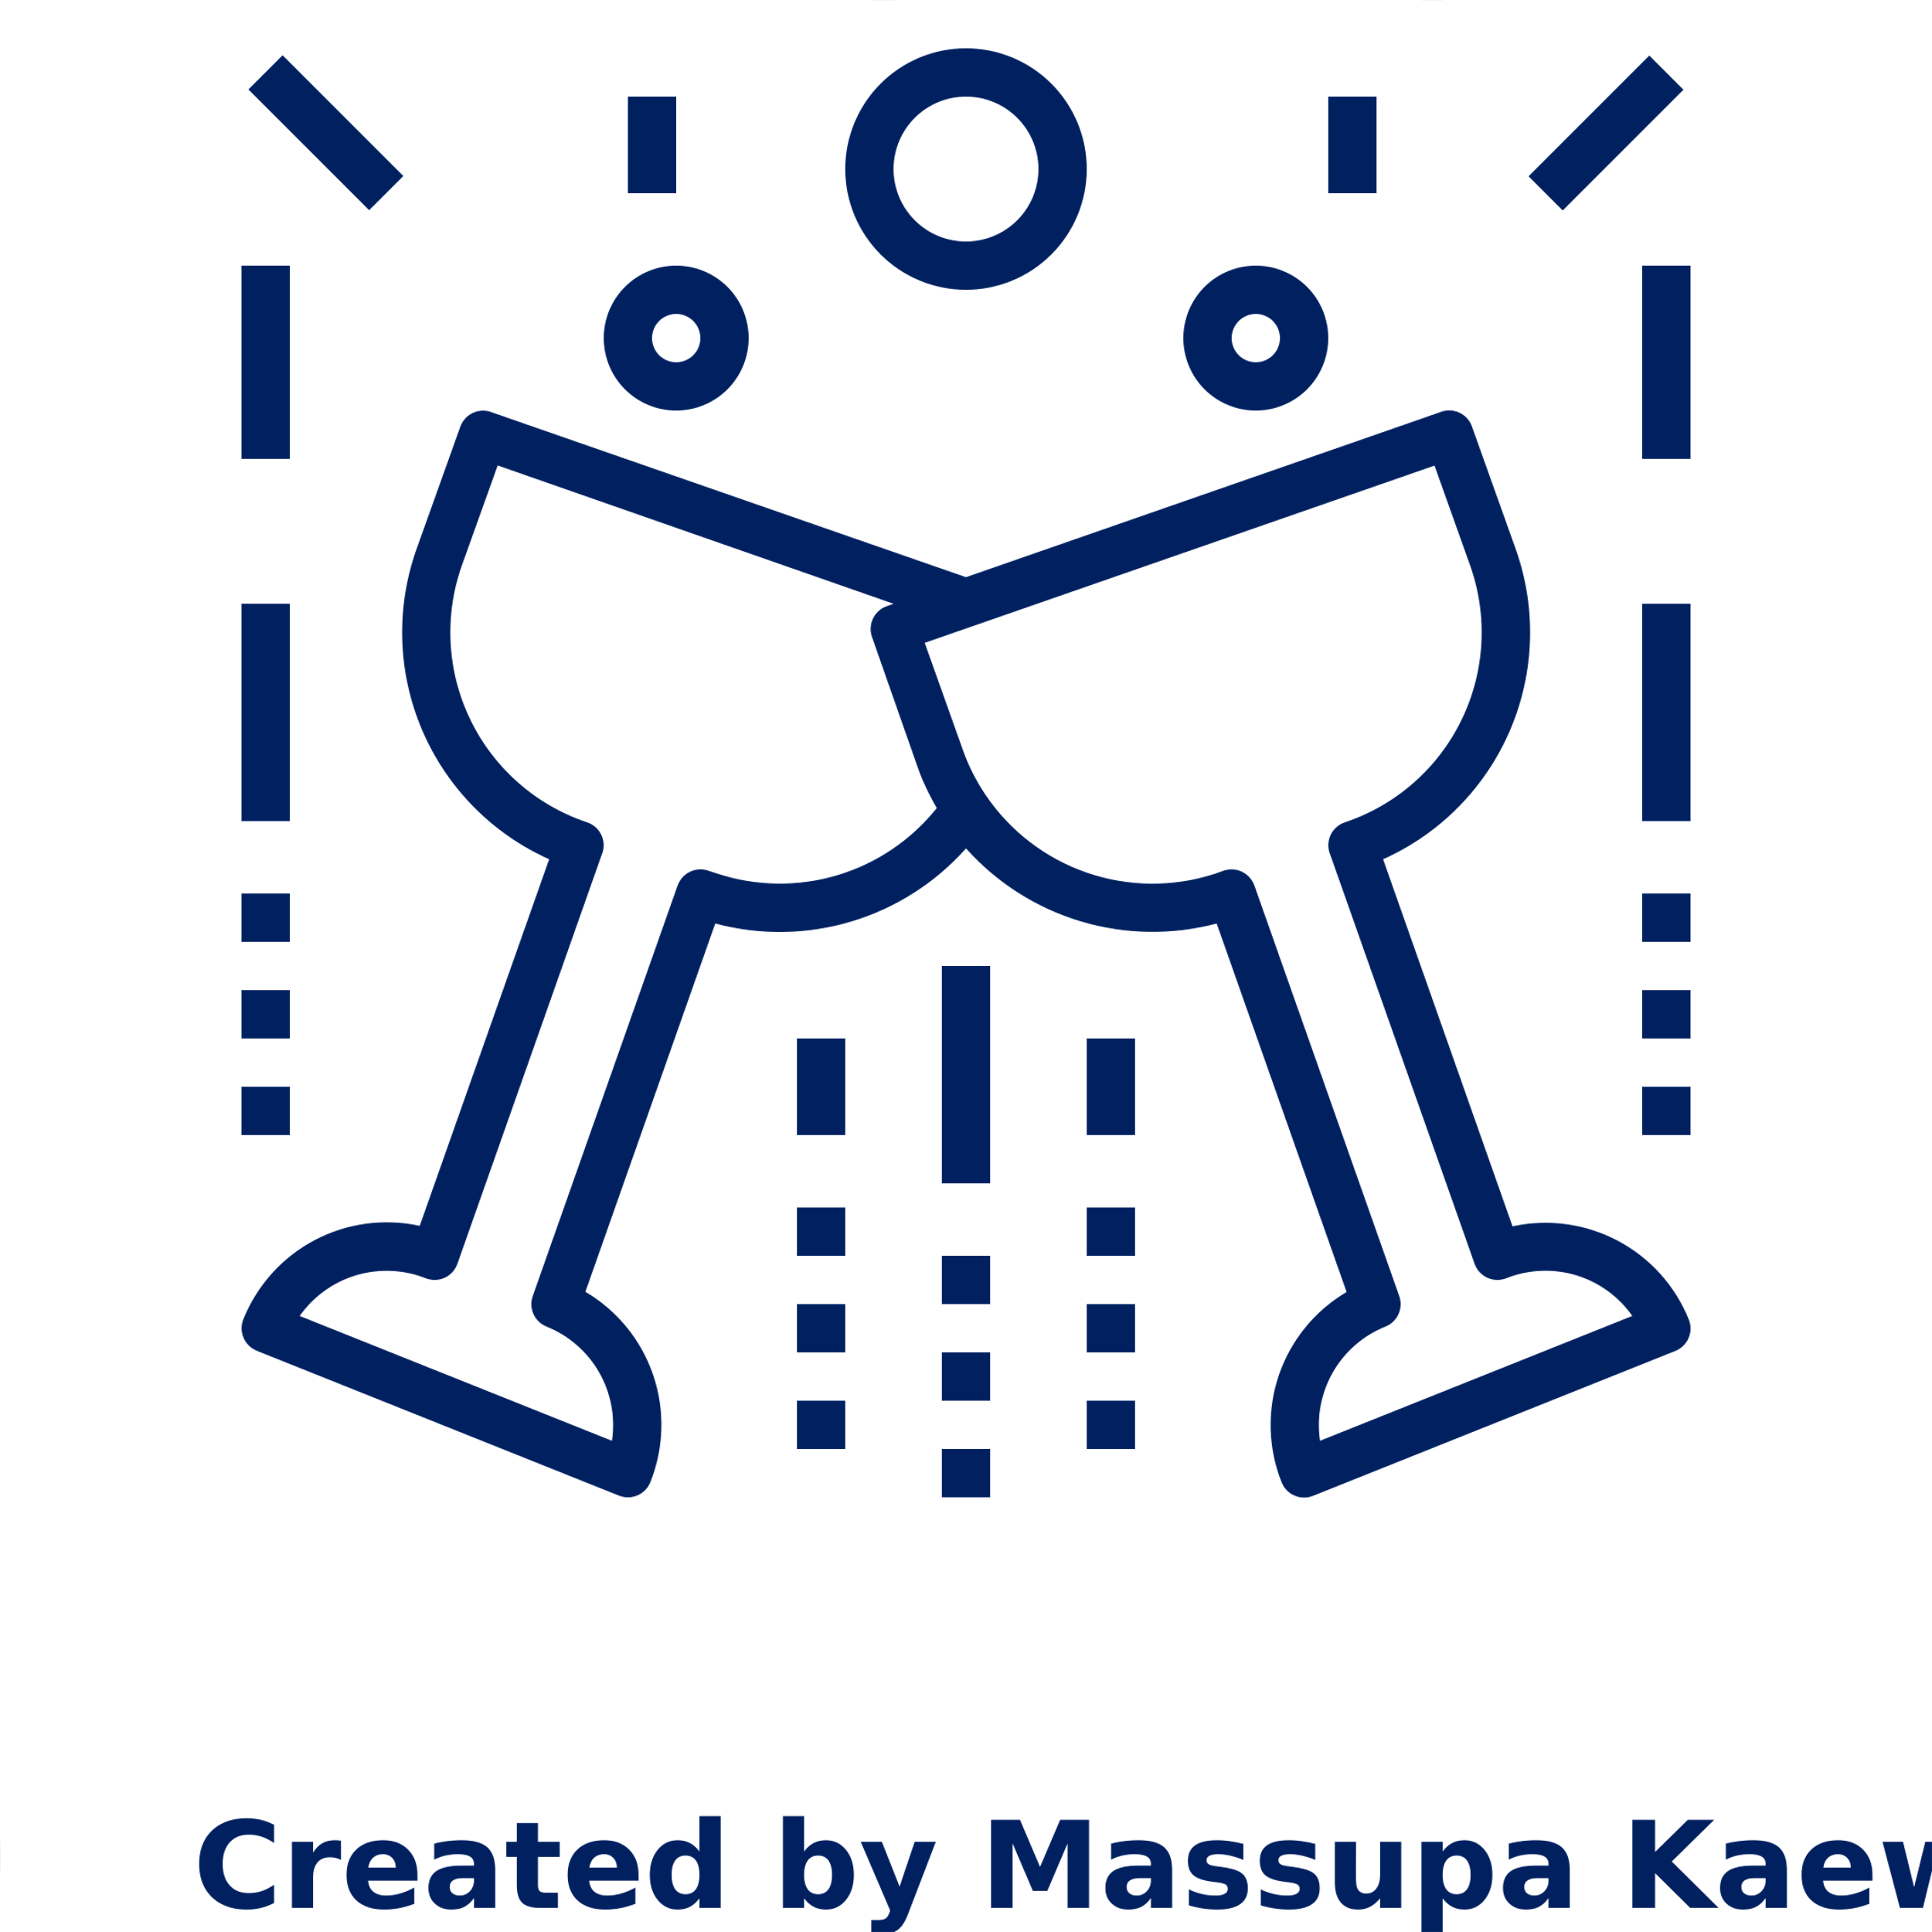
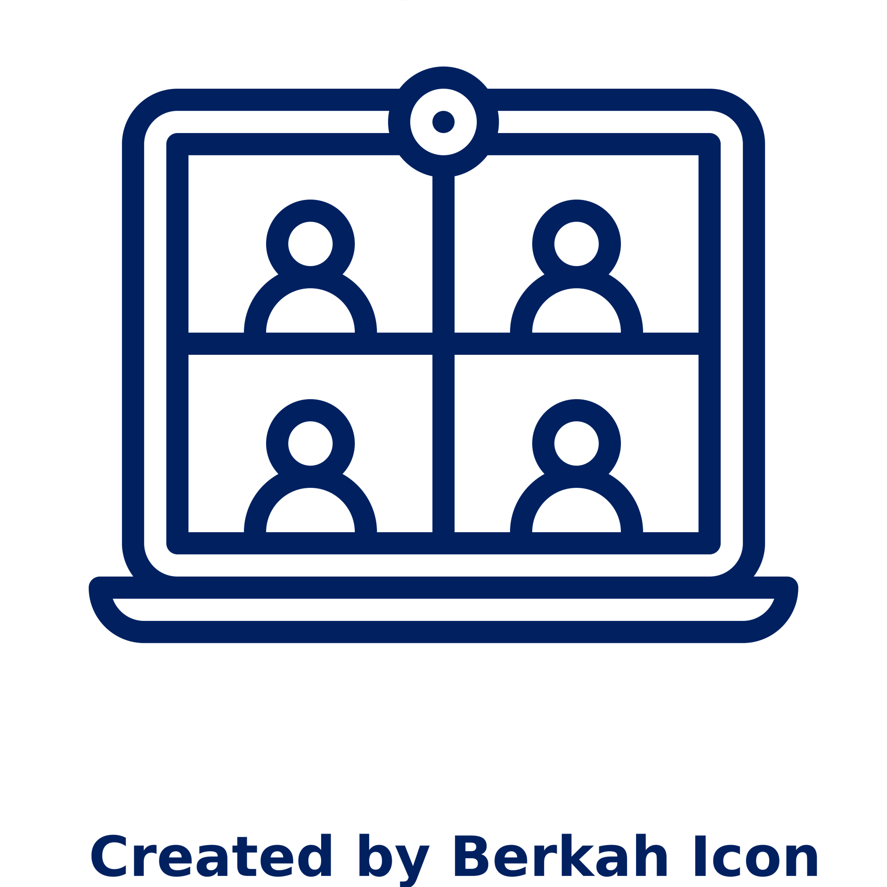



Umbrex connects you with a community of other top-tier independent consultants
Join our community
We create opportunities for our members to meet,
build relationships, share lessons learned, and collaborate
In-person events
Online events
Private online forum
Mastermind Groups
Free access to resources

Slide 80
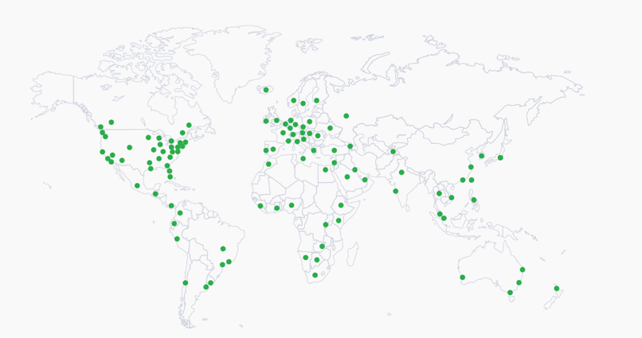
You're global and local - Umbrex is, too
Find a consultant now
Independent consultants available where you need them – in every global region

Slide 81
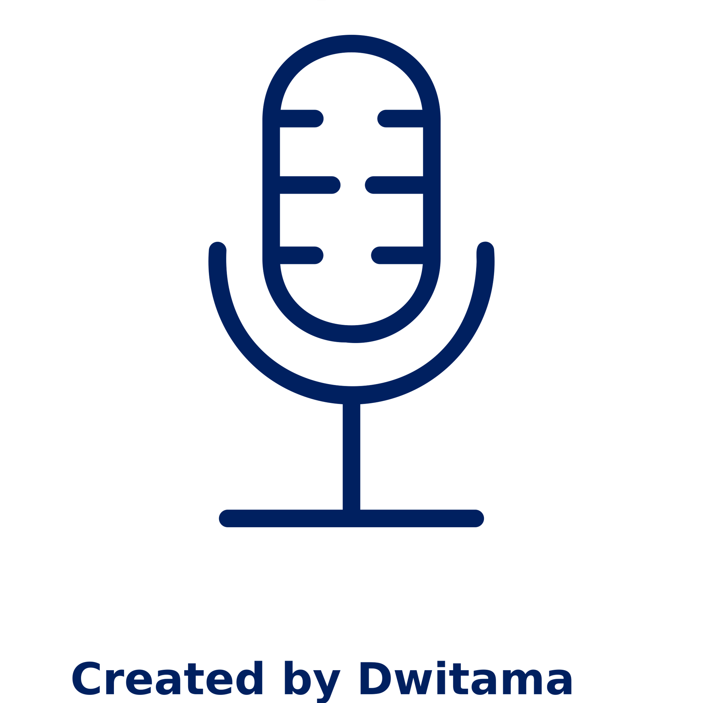


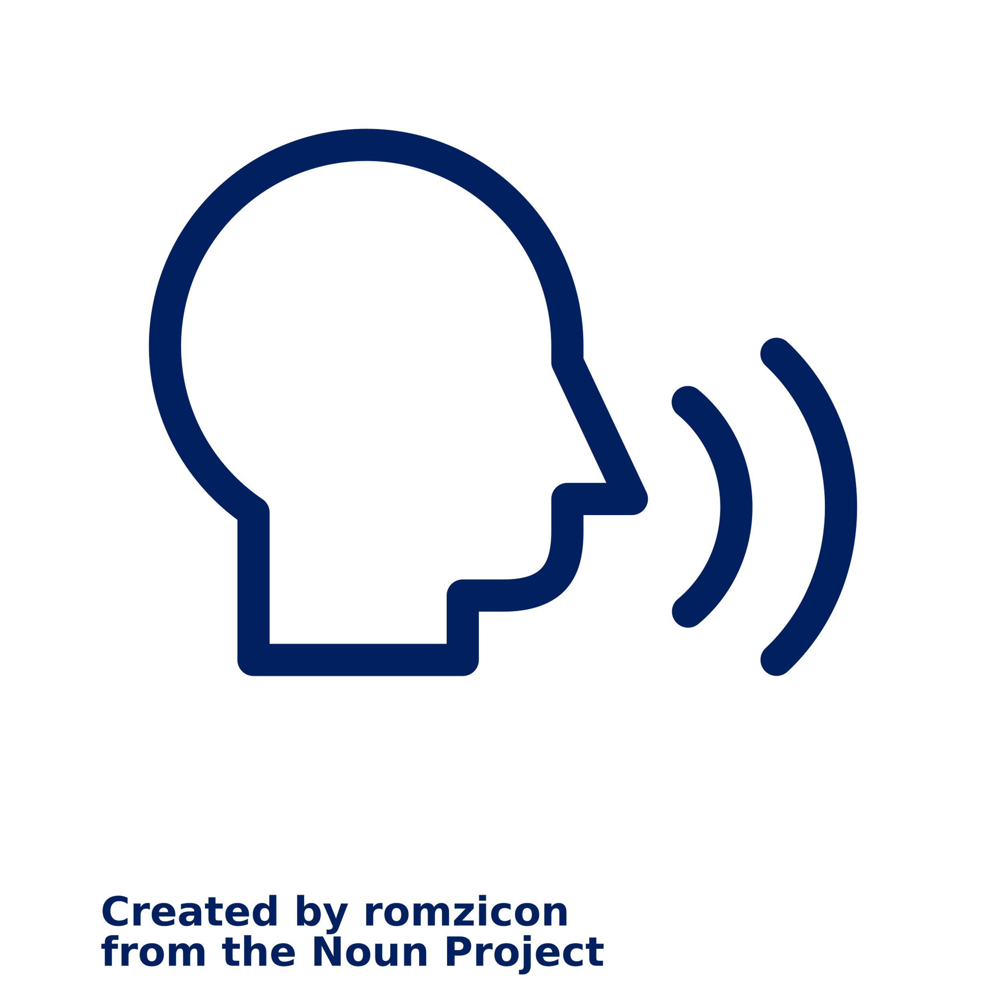
Umbrex thought leadership
Find a consultant now
Produce Unleashed, the leading podcast on how to thrive as an independent professional
Organized over 300 events for independent consultants
Over 1,000 consultants have used our video guide to set up their own practice
Invited speaker on independent consulting at business schools including Harvard, Wharton, Columbia, and Kellogg
Managing Partner Will Bachman recognized as a “Power Player Consulting” by Business Insider

Slide 82
How Umbrex can help
For Clients
For Consultants
Find a consultant now
Join our community

Slide 83

Umbrex provides resources to help consultants thrive
How To Set Consulting Fees
LinkedIn for Consultants: Best Practices to Optimize Your Profile
How To Find Clients For Your Consulting Practice
How to Build a Consulting Website
How to Write a Consulting Proposal: Guide and Templates
Guide To Setting Up Your Own Practice
And dozens more
Access resources

